Slide 1
OC ACM Executive Committee
Format: | Online via Zoom
Zoom Link: | https://acm-org.zoom.us/j/93004927026?pwd=NWRGR0RObUJWZFk5N0NjdFdBMUxEdz09
Date: | April 22, 2026

Slide 2
Agenda
Review of prior meeting minutes
Officers / Volunteers
Treasurer’s Report
Program Event Planning
Committee Business

Slide 3
Meeting Attendees
Michael Fahy
Allen Takatsuka
Dan Whelan
Marc Velasco
Nilo Niccolai
Winsor Brown
Ansel Teng
Don Choi
Trae Palmer
Raman Rajan
Shirley Tseng
Cynthia Kirkeby
Farhad Mafie
Jared Miller
Kenneth Aguilar
Dawn Childs
Taylor Noh
Stephen Landaas

Slide 4
Motions
Motion | Moved By | Seconded By | Status
Approve March 2026 Annual Business Meeting minutes

Slide 5
Officers
Position | Volunteer
Chair | Allen Takatsuka
Vice-Chair | Daniel Whelan, Ph.D.
Treasurer | Michael Fahy Ph.D.
Secretary | Daniel Whelan, Ph.D. (acting) - Open
Communications | Allen Takatsuka (acting) - Open
Webmaster | AJ Albrecht
Program Speaker Committee | Raman Rajan, Farhad Mafie, Dan Whelan
SIGAI-OC Liaison | David Harnick-Shapiro

Slide 6
Officers (cont’d)
Position | Volunteer
University Liaison | Michael Fahy Ph.D.
Membership Chair | Farhad Mafie
Program Video Coordinator
Social Media Chair | Jared Miller
Membership Committee
Hospitality | AJ Albrecht
Fundraising Coordinator
Members at Large | A. Winsor Brown, Shirley Tseng, Ansel Tseng, Dan Whelan

Slide 7
Treasurer’s Report EOM March 2026
Beginning Balance | $8,251.03 | 3/1/26
Expenses | $0.00
Deposits | $0.00
Current Balance | $8,251.03 | 3/31/26
Restricted Funds | $2,964.20 | IBM Grant
Unrestricted Balance | $5,286.83 | 3/31/26

Slide 8
2026 Program Event Planning
Date | Speaker | Talk
3/17/2026
 | Allen Takatsuka | Annual Business Meeting
1/20/2026
11/18/2026
9/16/2026
7/15/2026 | Dr. Nooshin Estakhri?
5/20/2026 | Donn M. Silberman | Quantum 2.0: Computing, Communications, Sensors & Workforce Development

Slide 9
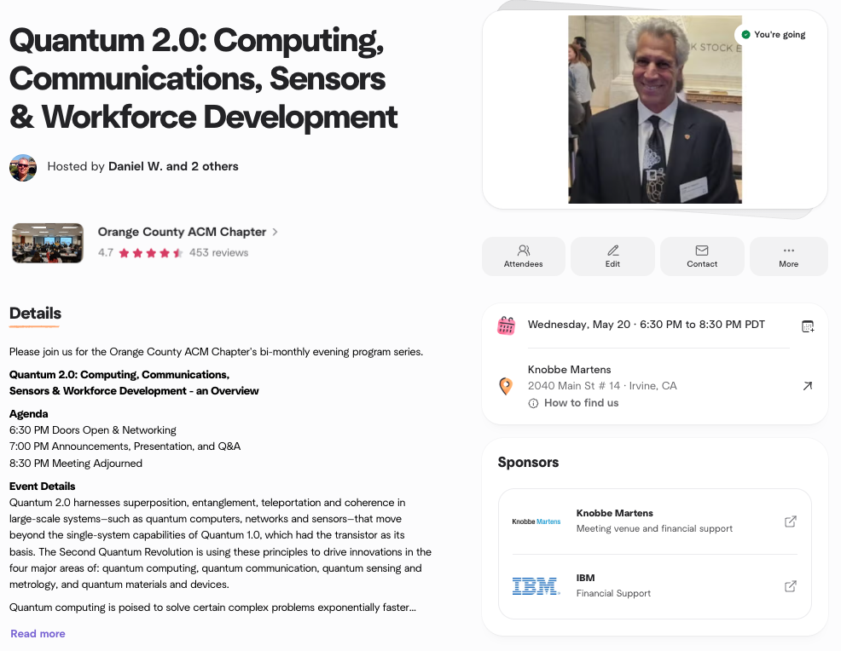
Upcoming May Event Planning
Speaker dinner
Confirm room
Snacks and beverages
Speaker Gift card
Speaker Certificate
Recording
Webpage

Slide 10
Future Program Event Candidates
Potential Speakers
Topics
July - Dr. Nooshin Estakhri is available [Dr Fahy]
Machine Learning
Control Theory & Robotics
System
Theory
Informatics

Slide 11
Committee Business
Volunteer Updates
Action Items
Website updates
Kenny Mitchell’s slides, revise program date to 2026
Ex Comm minutes
Officers
New/Other Business
Proposal to formally thank the 2025 board via LinkedIn?
Any concern of current funds balance?

Slide 12
Appendix

Slide 13
Future Program Event Candidates (UCI)
Machine Learning
Stephan Mandt (anomaly detection without supervised learning)
Roy Fox (reinforcement learning, robotics)
Jing Zhang (ML applied to bioinformatics)
Alex Berg (computational visual recognition, starts @UCI Spring 2022)
Control Theory & Robotics
Magnus Egerstedt, Dean of Engineering, Samueli School of Engineering
(Referred by Aaron Ames of Caltech)
System
Sang-Woo Jun (acceleration)
Sangeetha Jyothi (Data center networking)
Moshen Imani (bio-inspired computing)
Theory
Vijay Vazirani (involved with the design of early Google Ad Placement Alg.)
Informatics
Vladimir Minin (Data analysis wrt infectious diseases)
Stacy Branham (human-centered computing)

Slide 14
Future Program Event Candidates
Caltech Professor Yisong Yue, ML [Dan]
Andrew Kirkland, CISO at Starbucks
Beth Harnick-Shapiro [Marc]
Bill Lobig VP IBM Software Development - Analytics [Marc]
Christophe Begue, ex-IBM (Blockchain) now PDF Solutions
John Koon, Tech Idea Research - Autonomous Cars
Bill Cleveland – Data Visualization (M. Fahy has reached out to him)
Alanna Gombert, Global CRO at MetaX – Blockchain
Sushant Rao - Operational Analytic Data Stores (M. Fahy has reached out to him)
Paul Anderson, Anderson Software Group – Go language
Alyssa Columbus, Data Scientist at Pacific Life - Robust and Reproducible Predictive Modeling Workflows
Dianne Cook, Prof. of Business Analytics, Monash University – Data Visualization

